Slide 1


By Weronika Walaszczyk, Matylda Niedzielska, Antonina Łuczak

Slide 2

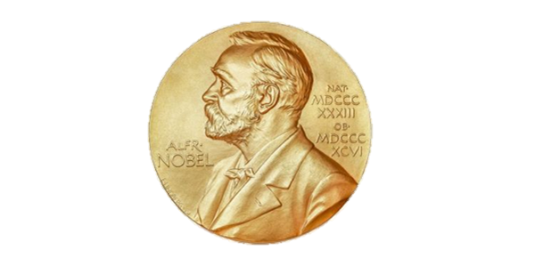

Slide 3
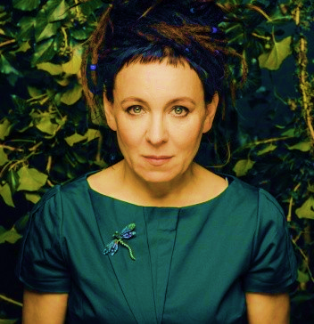


OLGA TOKARCZUK
Winner of the Nobel Prize in Literature for 2018
1962 – …
Her books have been translated into over 40 languages
She is also a screenplay writer
Winner of, among others, the International Booker Prize for the novel Bieguni
Two-time winner of the Nike Literary „Award for the Poles” and the „Books of Jacob”

Slide 4
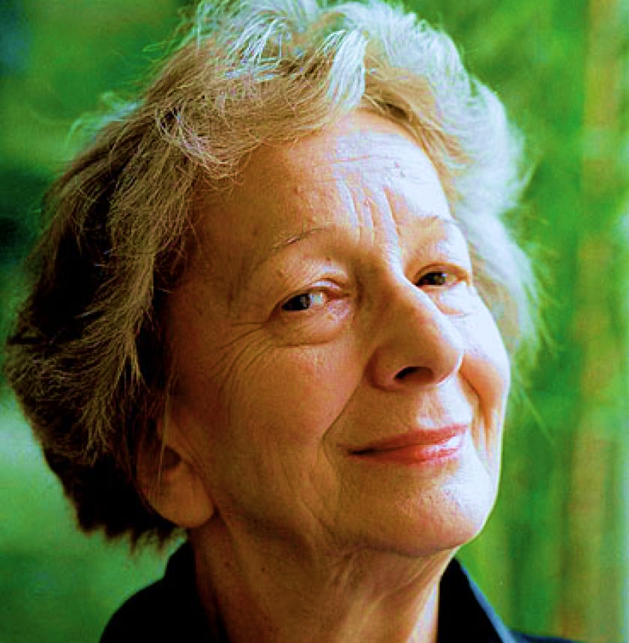
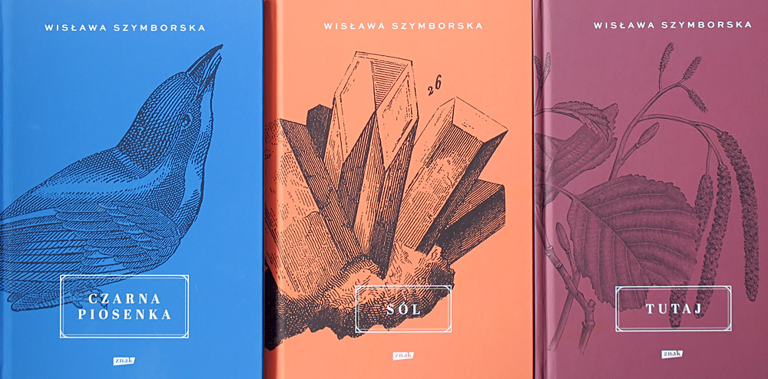

WISŁAWA SZYMBORSKA
1923 - 2012
Winner of the Nobel Prize in Literature in 1996
Published 13 volumes of poems for example: „A cry to Yeti”, „Salt”, „Just in case”
Her poems have been translated into over 40 languages
She also published translations of poetry, mainly from French and German
Received the Goethe, she was awarded the Herder Prize
Received the Order of the White Eagle

Slide 5




Slide 6
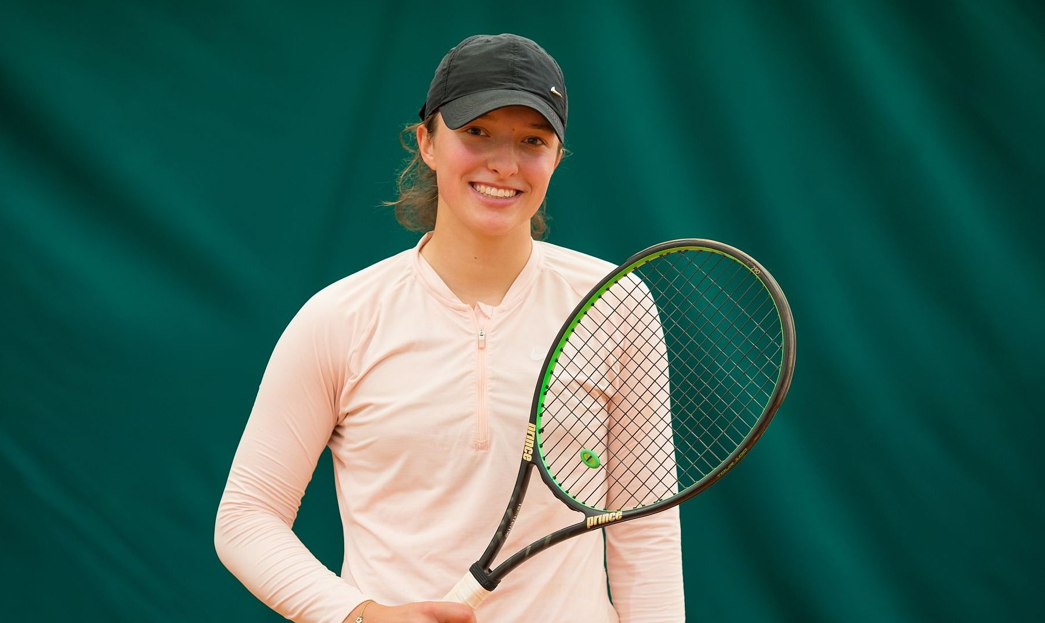
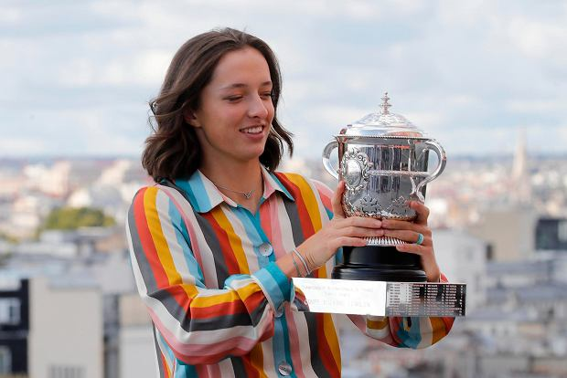
IGA ŚWIĄTEK
2001 - …
The most popular girl tennis player in Poland
She became the first Polish winner of the Grand Slam tournament in singles and French open 2020
Her professional career began at the age of 15
It was then that she played on the big court for the first time and won ITF in Stockholm. A year later,
she won the second ITF tournament in Bergamo
(city in Italy) ​
​
​

Slide 7
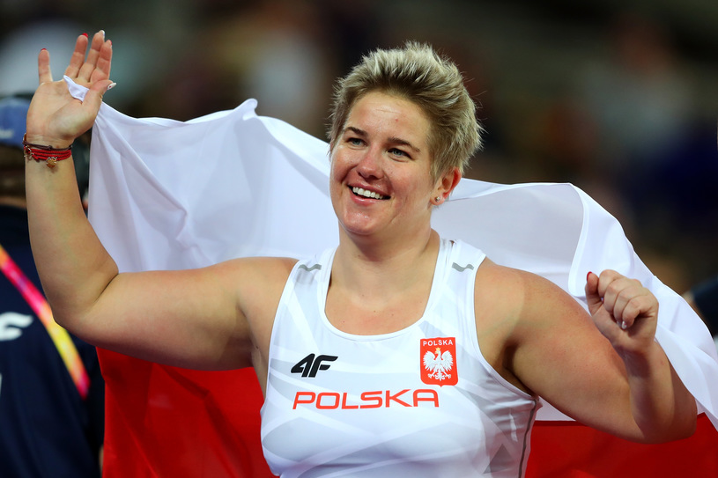
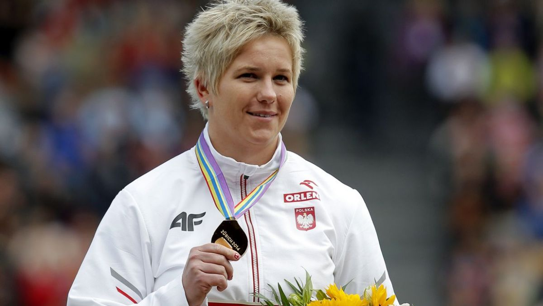
ANITA WŁODARCZYK ​
1985 - …
Polish athlete, two-time gold medalist of the Olympic Games, four-time world champion and multiple world, European and national record holder in the
hammer throw.
In her early youth she trained speed bike - in 1998 she became the European junior team champion
Received the Knight's Cross of the Order of Polonia Restituta and Officer's Cross of the Order of Polonia Restituta

Slide 8
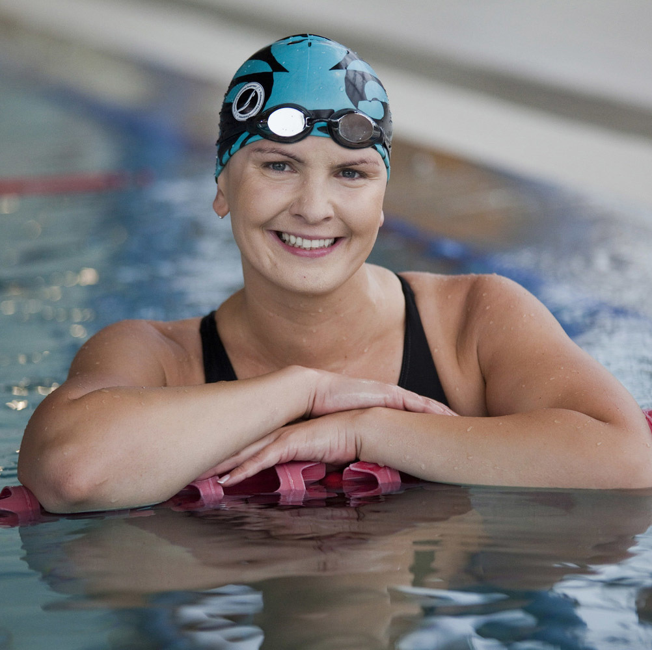
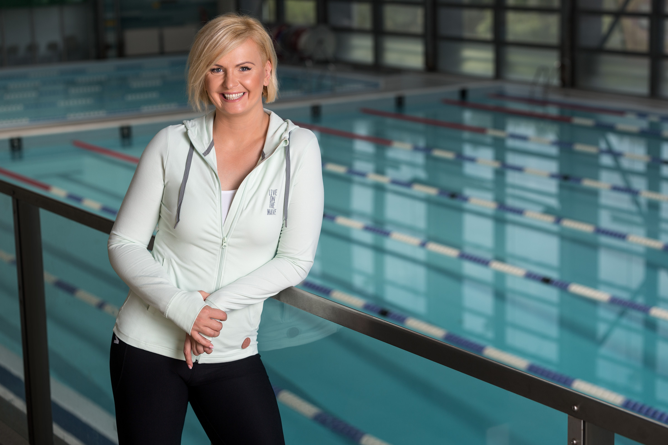
OTYLIA JĘDRZEJCZAK
1983 - …
Polish swimmer specializing in butterfly and freestyle, Olympic champion, two-time world champion, five-time European long-pool champion, three-time world record holder
In July 2003 she became the world champion in the
200 m butterfly style, with a time of 2: 07.56
In 2014, she ended her sports career and took the position of the president of the Polish Women's Sports Association

Slide 9


P
O
L
I
S
H
C
H
E
M
I
S
T
R
Y
W
O
M
A
N

Slide 10

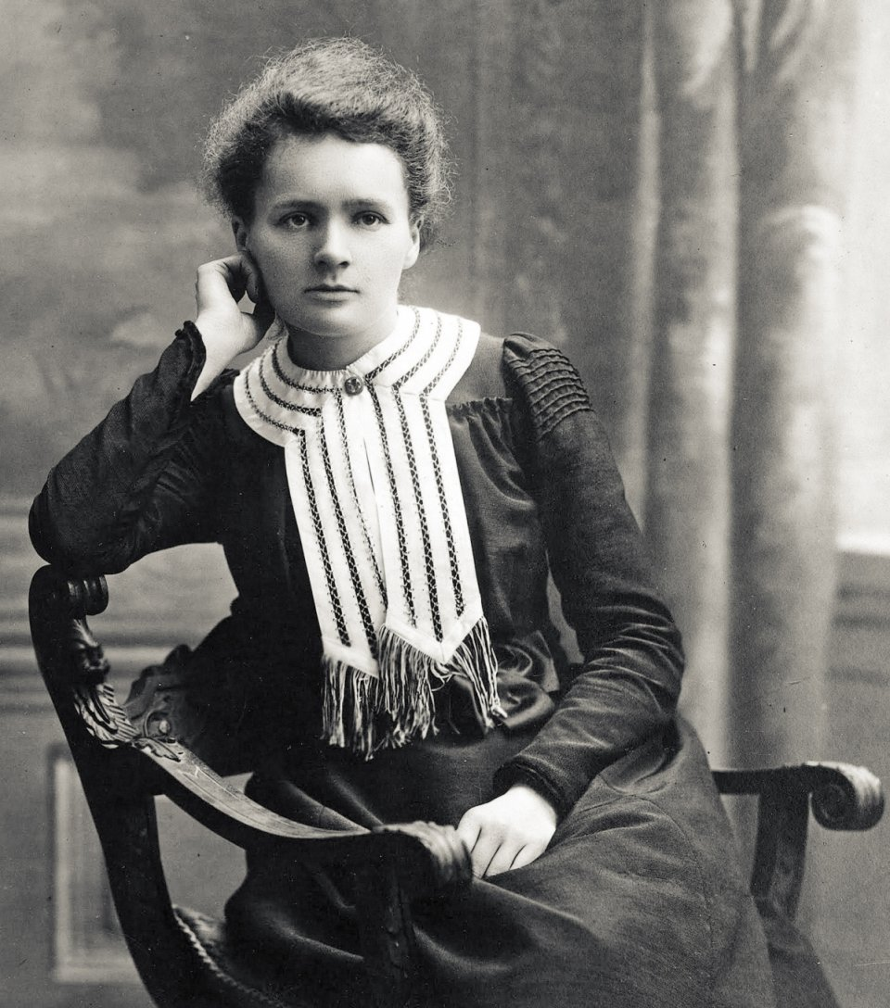
1867 - 1934
​
Polish physicist and chemist, two-time winner
of the Nobel Prize
In 1897 announced the first scientific work on the magnetic properties of hardened steel.
She was awarded the Nobel Prize for the first time in 1903 - in physics, together with her husband Pierre Curie and with Henri Becquerel, for research into the phenomenon of radioactivity discovered by Becquerel.
She was awarded for the second time in 1911 - in chemistry for the discovery of polonium and radium, the separation of pure radium and the study of the chemical properties of radioactive elements.
! She is one of only four people who have received the Nobel Prize more than once. ​

Slide 11

By Weronika Walaszczyk, Matylda Niedzielska, Antonina Łuczak

